Slide 1
Home Maintenance App
For Renters

Slide 2
Project Description
Problem:
When it comes to home maintenance, it is difficult to know all the information about items in your home. Every time something breaks, for example, and you need to call a repair company, you have to keep checking the model of the object, and the date you last serviced it. It's impossible to remember all of this information!
Problem Solved:
A prototype of an application that helps homeowners and renters keep track of routine maintenance information. The goal is to allow easy access for homeowners/renters when contacting professional repair companies about the windows, light bulbs, and heaters in their home.

Slide 3
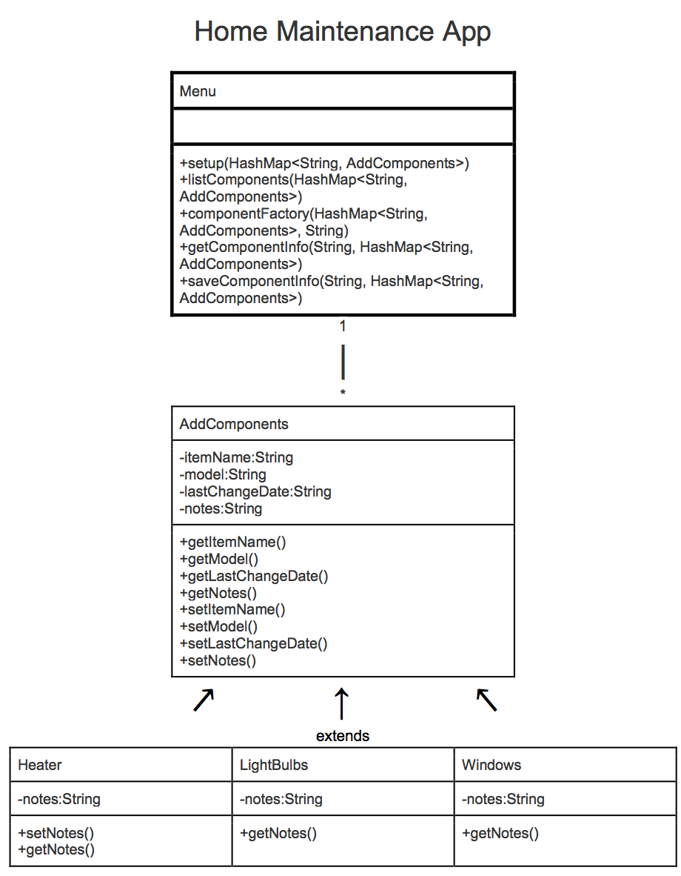
UML

Slide 4
Data Structures and Design Patterns Implemented
A hashmap is used to store all components a user adds
Dynamically allocated: can add unlimited components, allocating memory as needed
A factory is used to create components
Method in the Menu class create objects of a different class and its subclasses based on user input
User doesn’t know subclasses exist: works as a facade as well

Slide 5
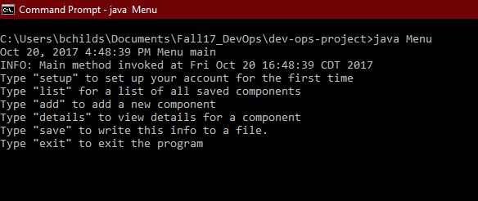
Menu

Slide 6
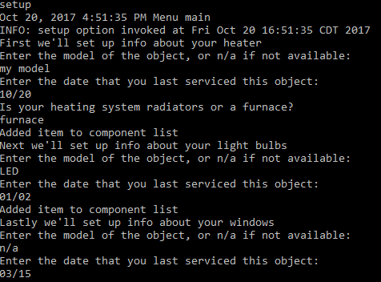
Set Up

Slide 7
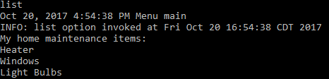
List

Slide 8
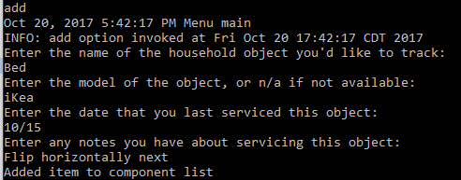
Add

Slide 9
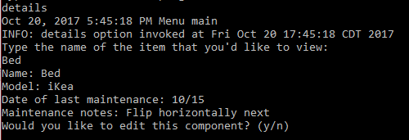
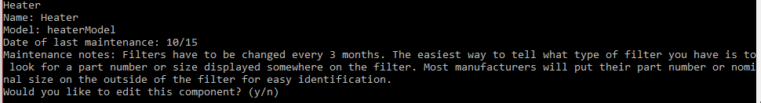
Details

Slide 10
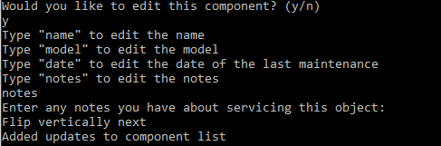
Edit

Slide 11

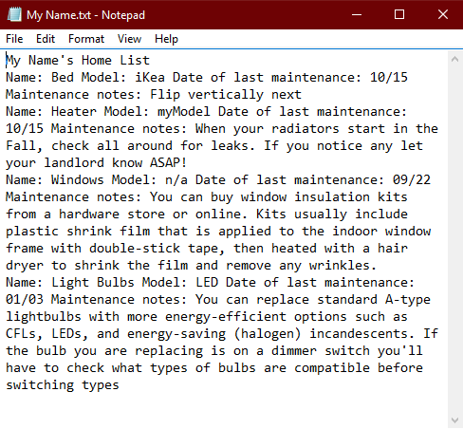
Save

Slide 12
AWS Infrastructure
Storage: S3 bucket
Single user app
Infrequent use
Output stored in text files
Since most users only have a few components, ctrl + f is more efficient than SQL
Security: private subnet
App doesn’t need access to the WAN

Slide 13
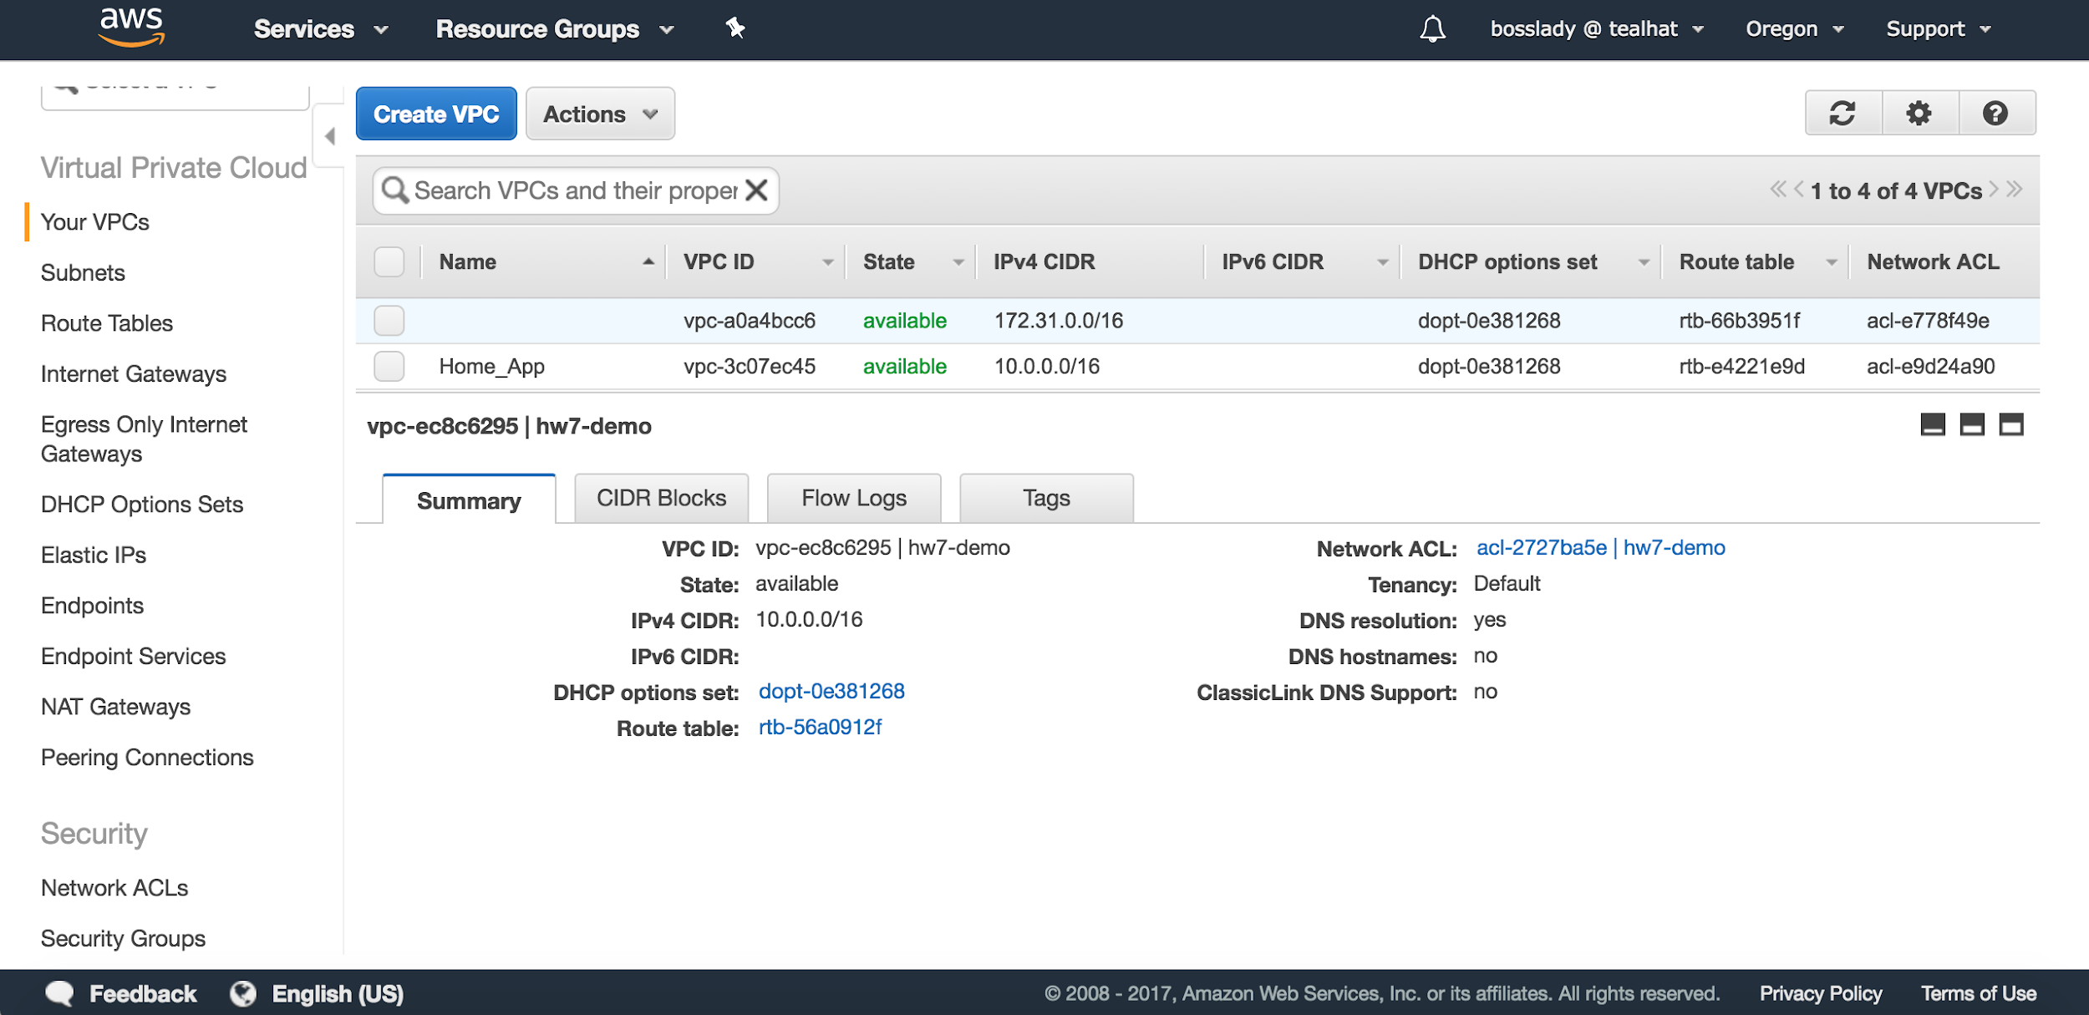
VPC

Slide 14
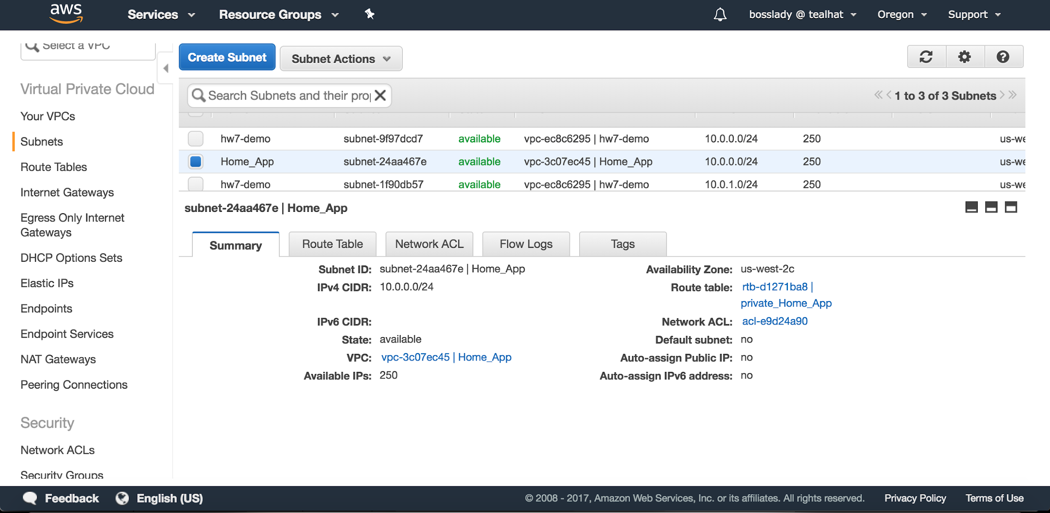
Private Subnet

Slide 15
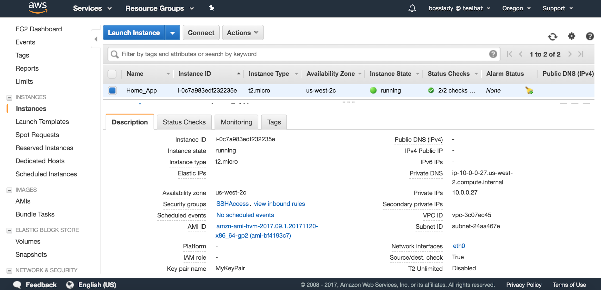
EC2

Slide 16
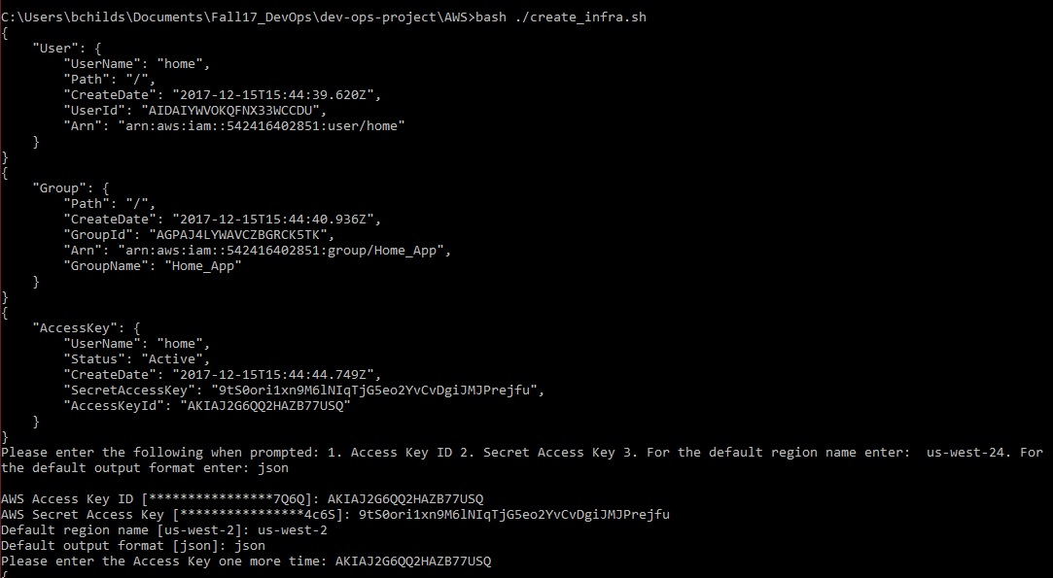
Create User, Group, Config Profile

Slide 17
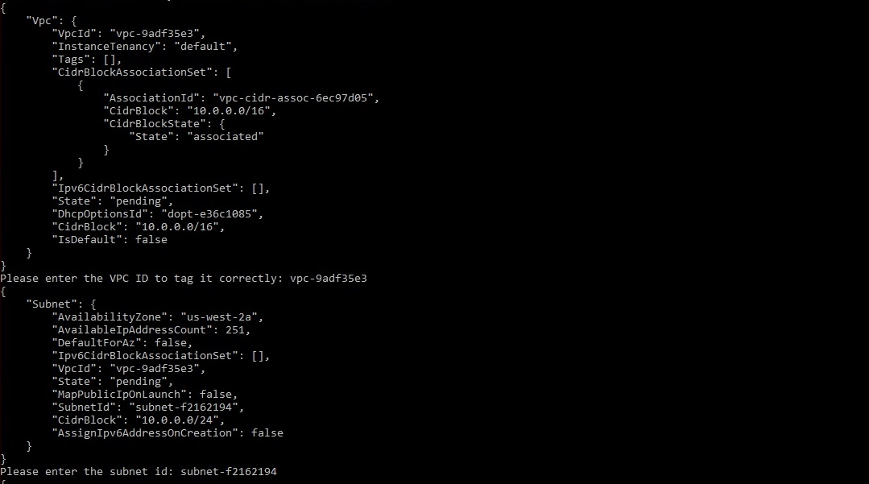
Create VPC and Private Subnet

Slide 18
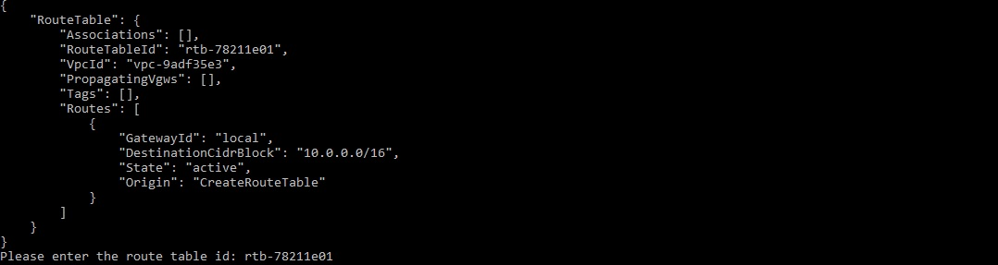
Create Route Table

Slide 19
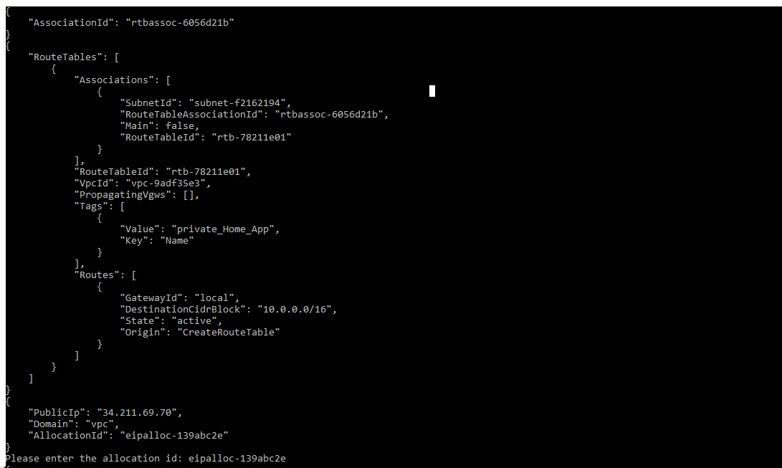
Create Elastic ID

Slide 20
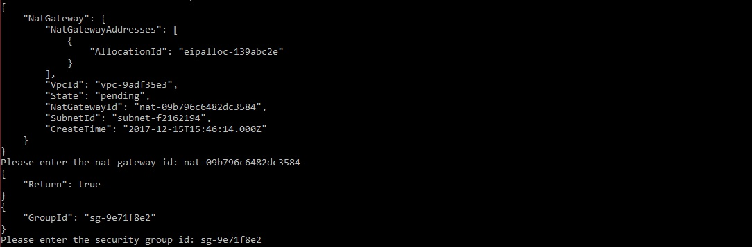
Create NAT Gateway and Security Group

Slide 21
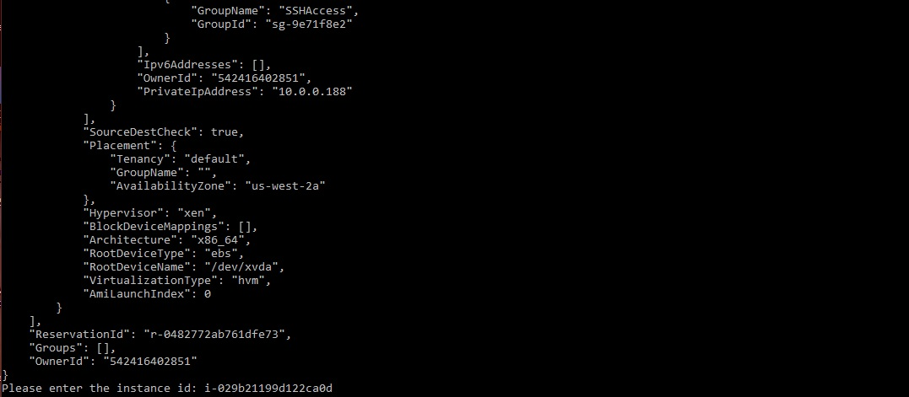
Create Instance

Slide 22
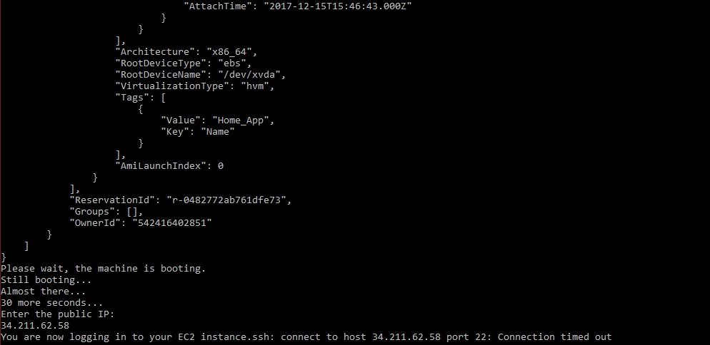
Boot Machine and SSH in

Slide 23
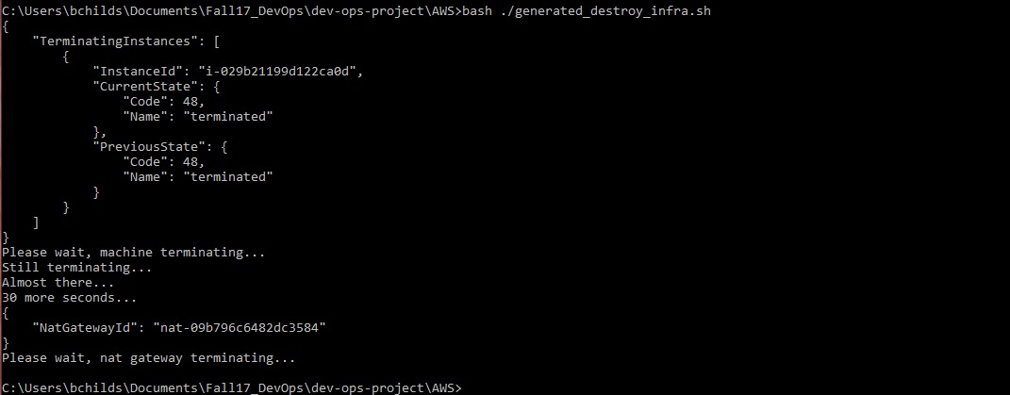
Destroy!

Slide 24
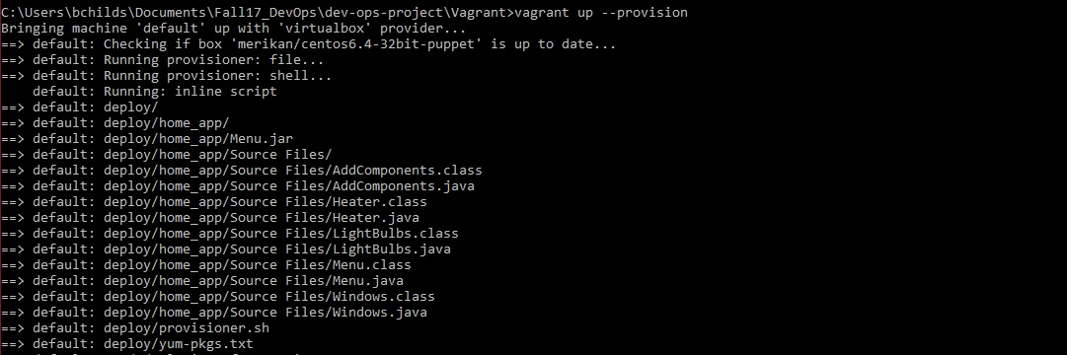
Vagrant up --provision

Slide 25
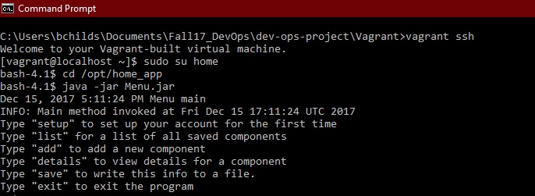
Vagrant ssh
Notes:
Images of using vagrant create, use the app, and destroy

Slide 26
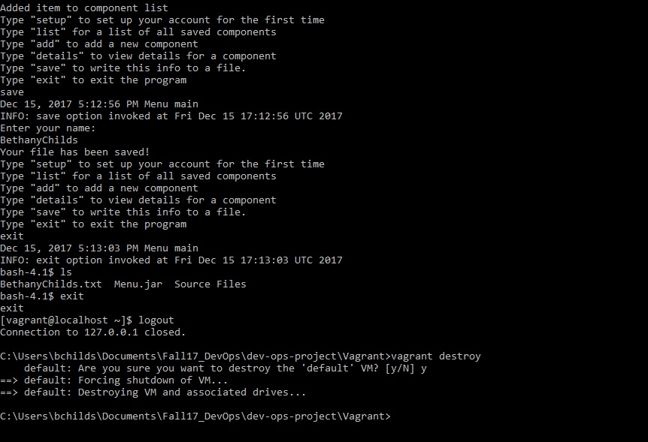
Save and Destroy!

